Slide 1
Heart Stroke Prediction
By Group 12:
• Abbasi, Seyed Amir Kiarash
• Alan, Baris
• Ardalanasl, Mohammad
• Khimani, Renish Samir
• Li, Chue San Gavin
• Maran Vieira Da Silva, Taiguara
• Mehmood, Hassan
• Monzato Grigorio, Gabriel
• Thomas, Shane

Slide 2
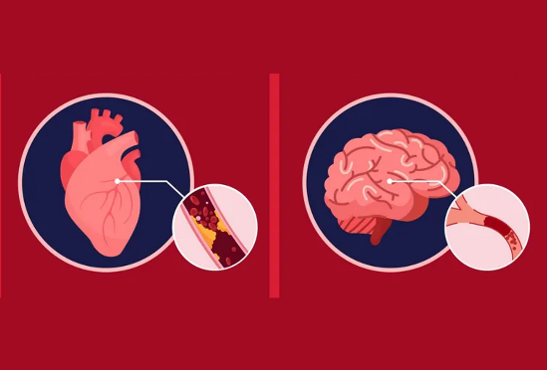

Predicting Heart Stroke
How are we going to predict?
The Data
Residence Type
Average Glucose Level
BMI*
Smoking Status
Stroke
Gather data obtained from Kaggle
Identify the risks associated with Heart Stroke
Creating a probability of the risk of Heart Stroke with historical Data
Give our findings to doctors and professionals so they can decide on the threshold
ID
Gender*
Age*
Heart Disease
Hypertension
Ever married
Work type

Slide 3
Add your first bullet point here
Add your second bullet point here
Add your third bullet point here

Slide 4
Title and Content Layout with Chart

Slide 5
Two Content Layout with Table
First bullet point here
Second bullet point here
Third bullet point here
Class | Group A | Group B
Class 1 | 82 | 95
Class 2 | 76 | 88
Class 3 | 84 | 90

Slide 6
Two Content Layout with SmartArt
First bullet point here
Second bullet point here
Third bullet point here
Step 1
Task Description
Task Description
Step 2
Task Description
Task Description
Step 3
Task Description
Task Description

Slide 7
Add a Slide Title - 1

Slide 8
Add a Slide Title - 3

Slide 11
Add a Slide Title - 4

Slide 12
Add a Slide Title - 5

